Slide 1
CHAPTER 16
The Citric Acid Cycle
Xiao-Wei Chen, Ph.D.
xiaowei_chen@pku.edu.cn

Slide 2
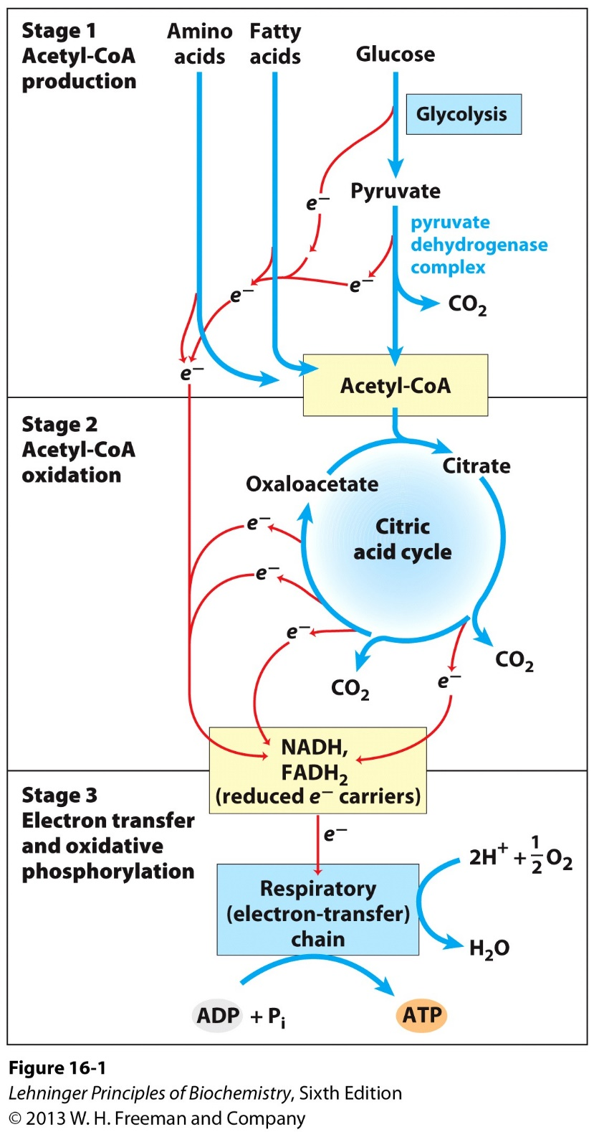
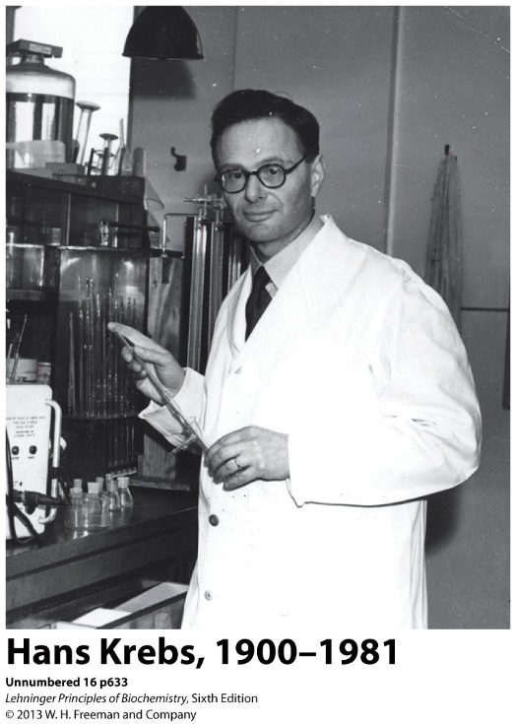
The Citric Acid Cycle
Also known as the Tricarboxylic Acid Cycle (TCA),
or the Krebs Cycle
The final common pathway involved in the oxidation of carbohydrates, fats, and proteins into CO₂ and H₂O to generate ATP by linking with oxidative phosphorylation);

Slide 3
The TCA cycle connects catabolism and anabolism
From many to one
From one to many
The TCA cycle provides precursors for the biosynthesis of many compounds (e.g. amino acids), as an amphibolic hub of metabolism.

Slide 4
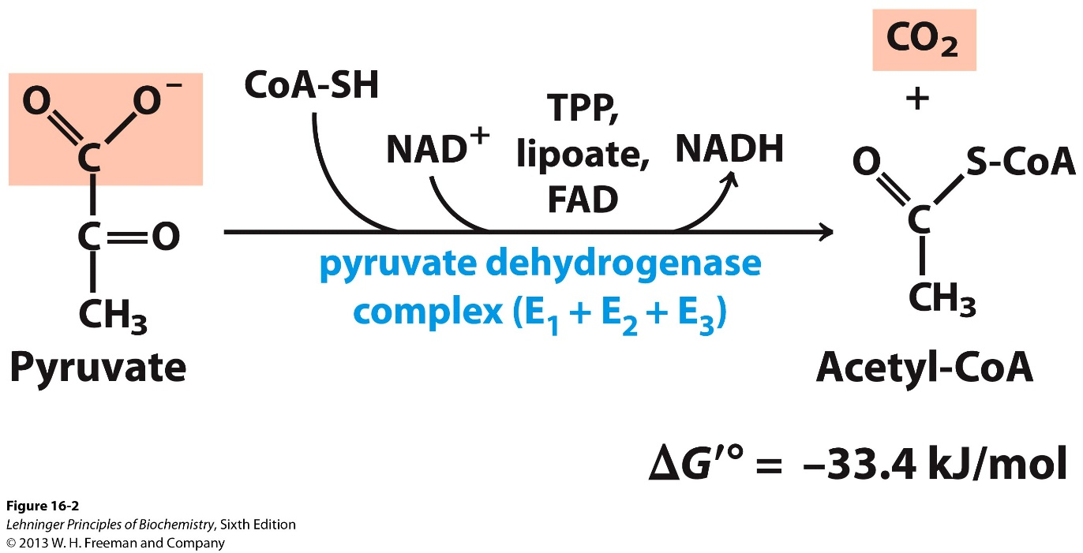
Pyruvate “activation” by the Pyruvate Dehydrogenase (PDH) Complex
PDH complex: three enzymes and five co-enzymes
Prototype of other decarboxylation enzyme complexes
Allosterically and covalently regulated

Slide 5
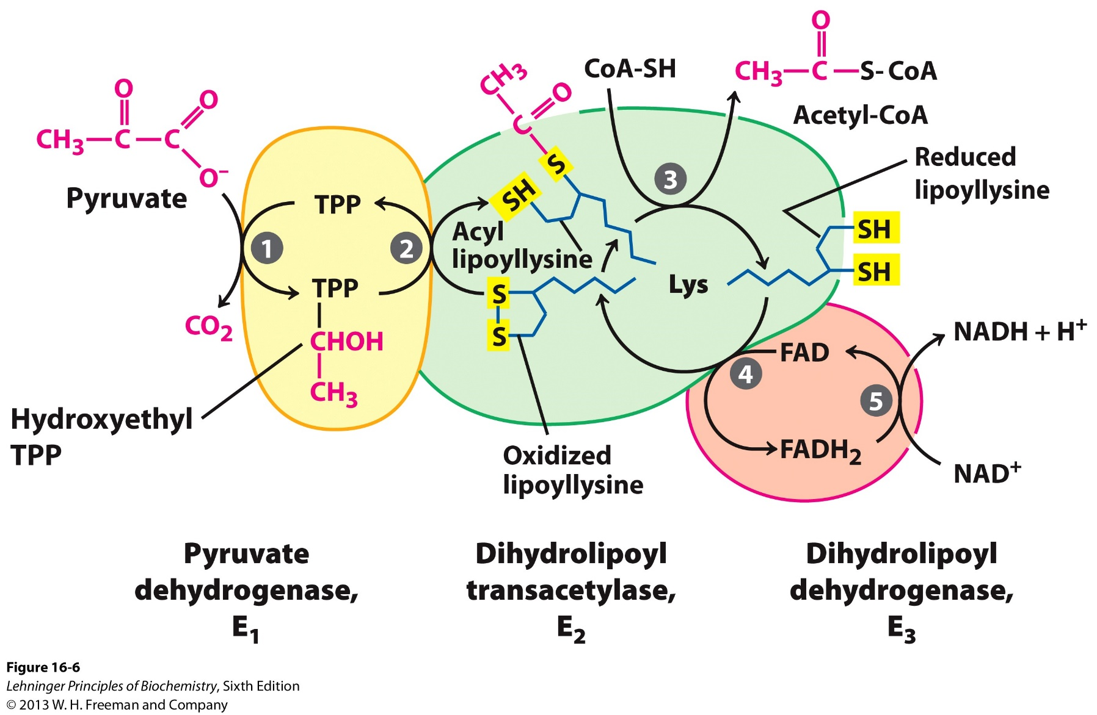
The three enzymes in the Pyruvate Dehydrogenase (PDH) Complex

Slide 6
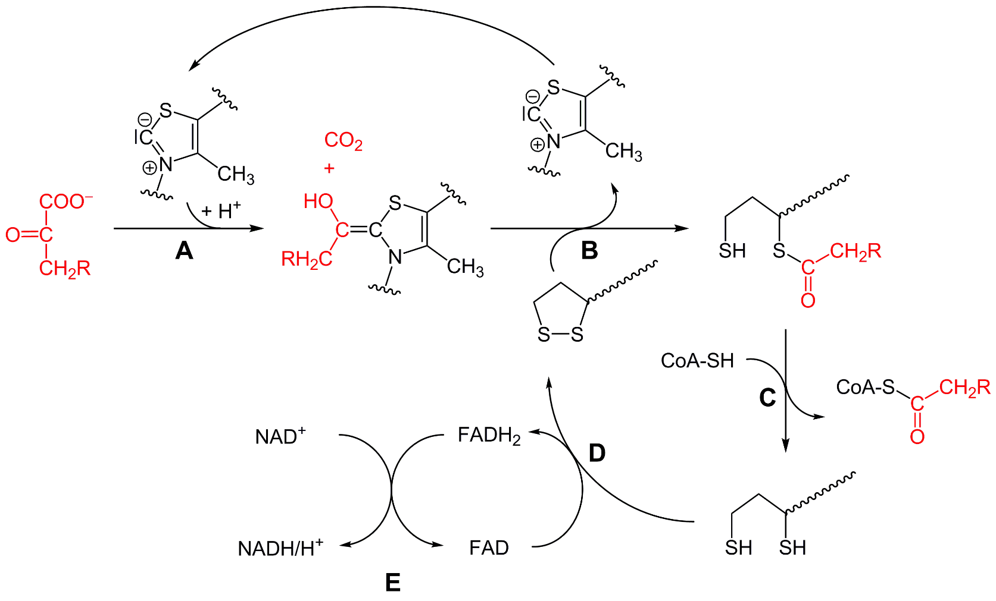
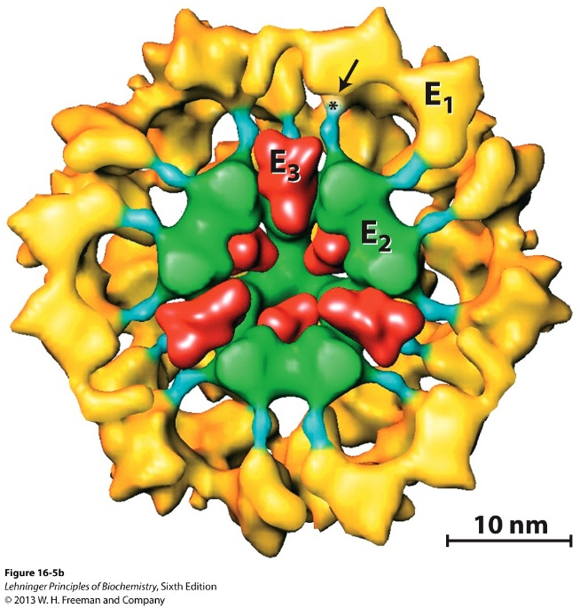
The five reactions catalyzed by the Pyruvate Dehydrogenase (PDH) Complex

Slide 7
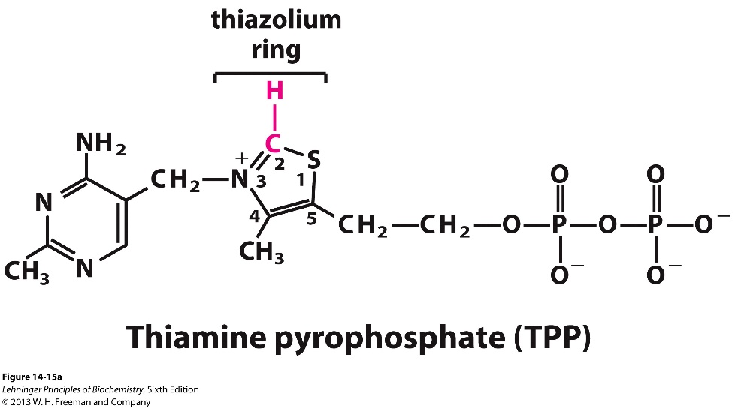
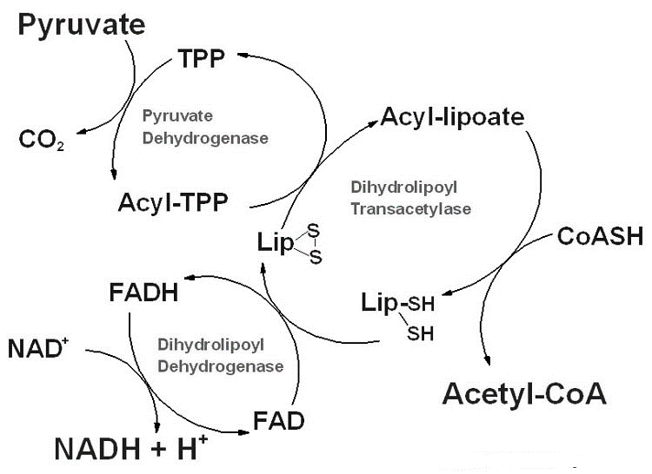
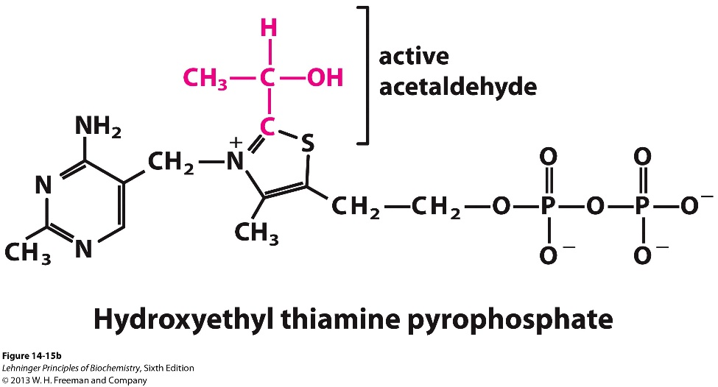
Step 1: Pyruvate decarboxylation by E1
Decarboxylation releases a lot of free energy, driving the following endogonic reactions

Slide 8
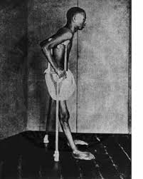
Thiamine deficiency: Beriberi (不能不能)
Associated with polished rice(white rice) as major dietary food
Neurological and muscle disorders (the organs mostly dependent on oxidative metabolism)

Slide 9
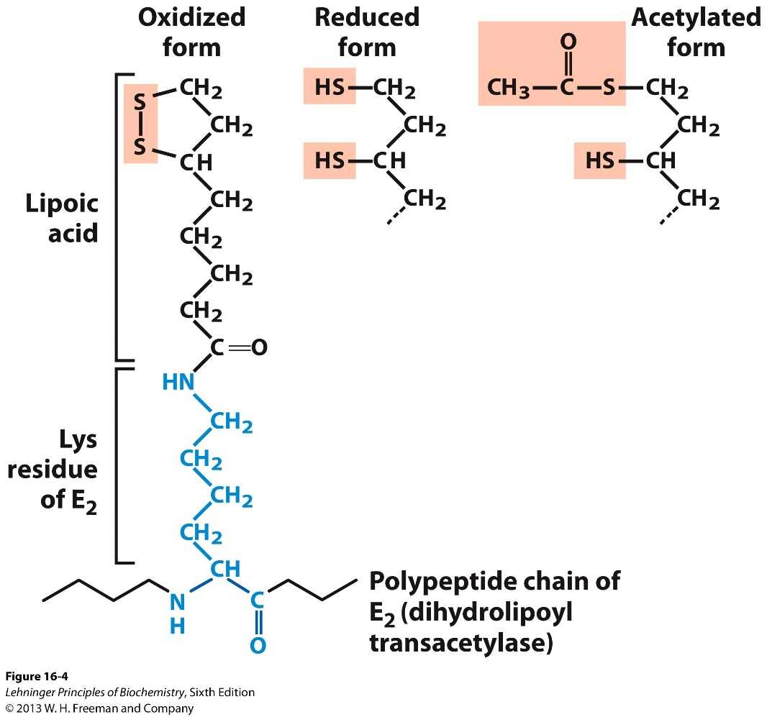
Step 2: Oxidation-Reduction and formation of Acyl-lipoate by E1

Slide 10
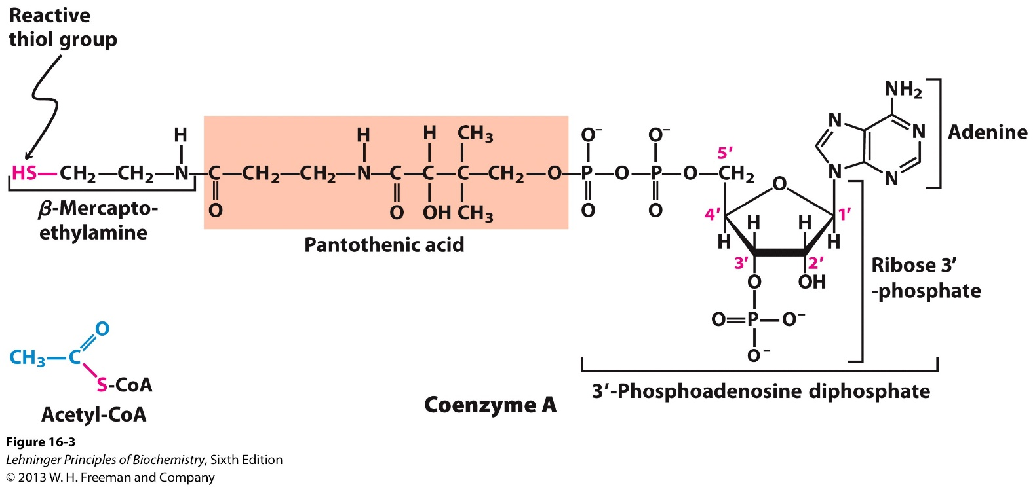
Step 3: Formation of Acetyl-CoA by E2

Slide 11
Step 4, 5: Oxidation-Reduction and generation of NADH by E3
Re-generation of oxidized Lipoate (disulfide bonds)
Uses NADH and FADH₂ as co-enzymes.
E1+E2+E3:
Closely coupled
No dissociation of intermediates
Enabled by long “arms” of lipoate
So-called “substrate channeling”

Slide 12


Pyruvate Dehydrogenase Complex Deficiency
One of the most common form of neurodegenerative disease. Why?
Possible treatment?
Low carbon, high fat diet
Why?

Slide 13
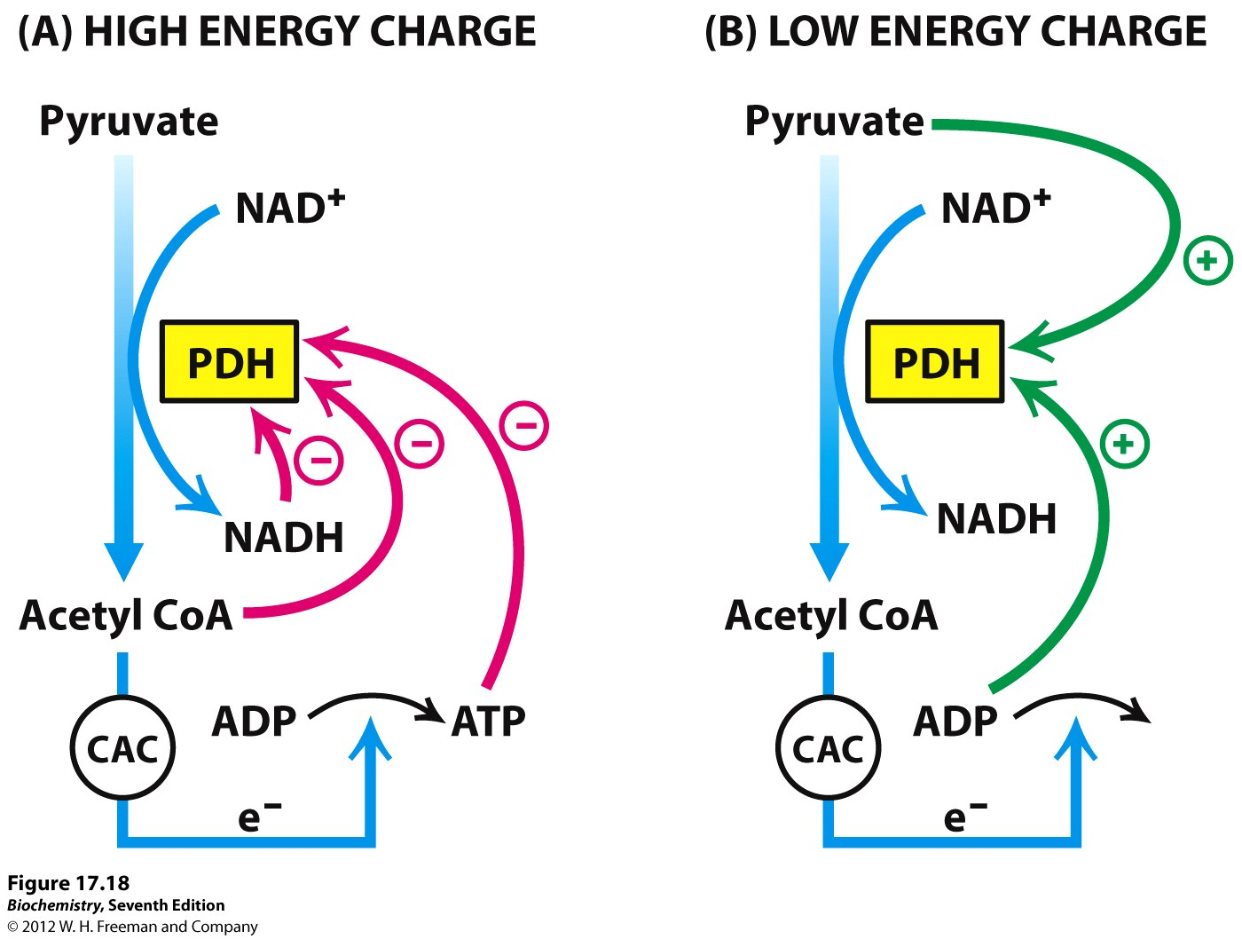

Allosteric regulation of the PDH complex

Slide 14
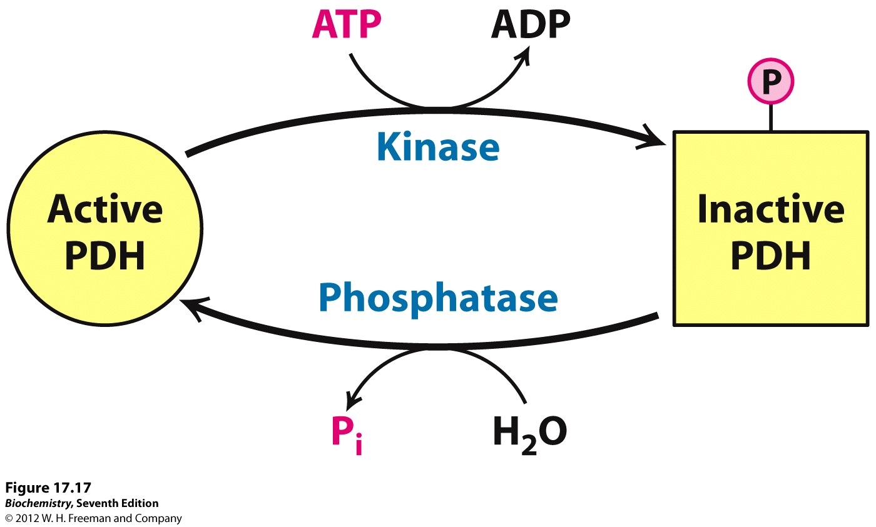
Covalent regulation of the PDH complex
Muscle contraction
Epinephrine in liver

Slide 15
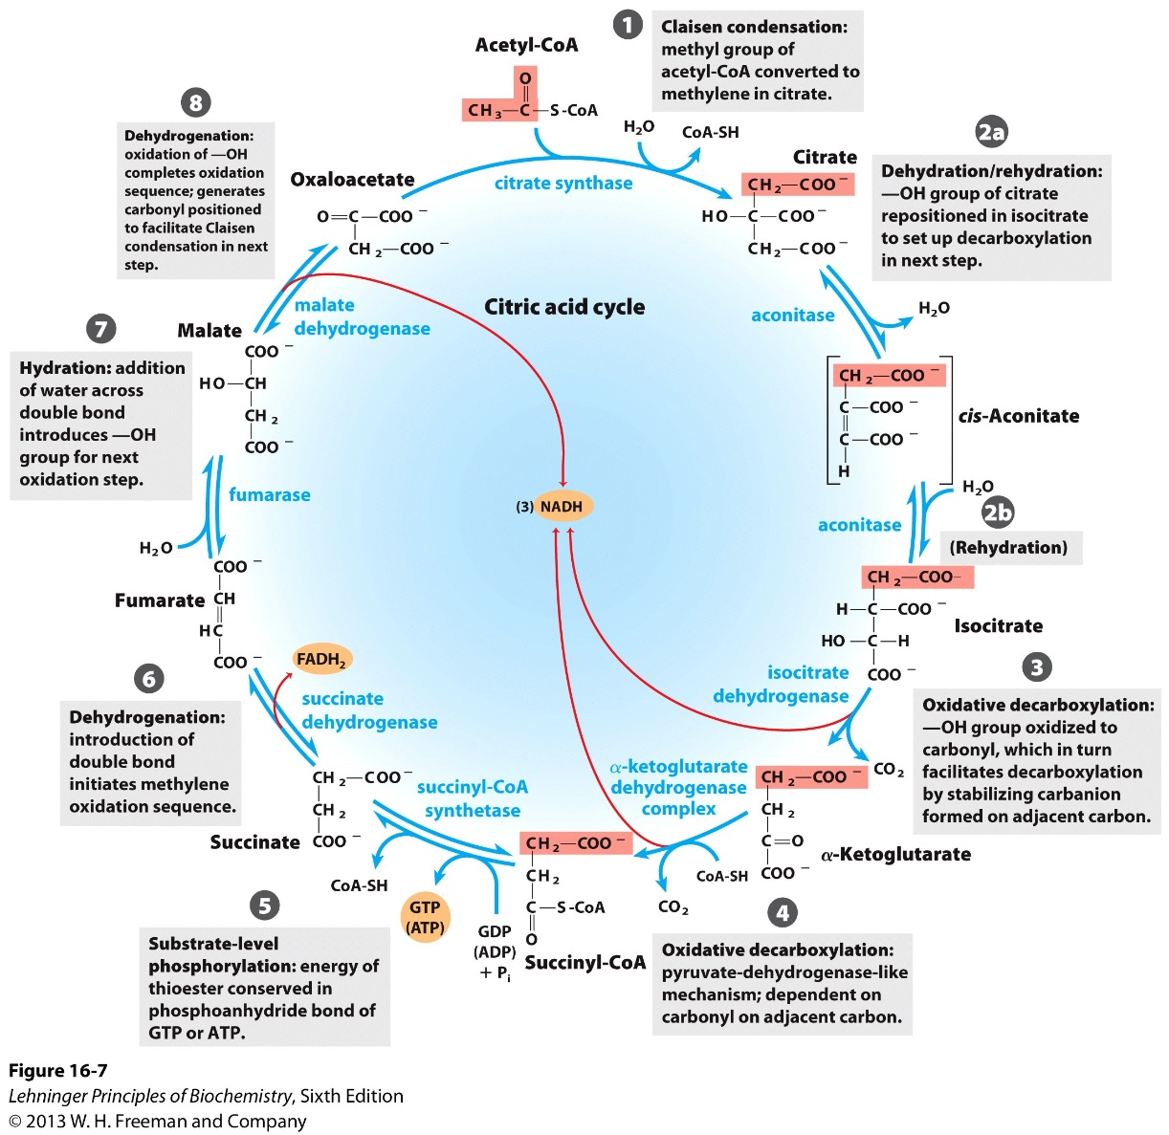
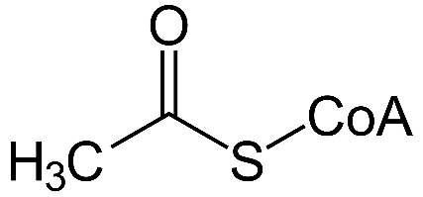
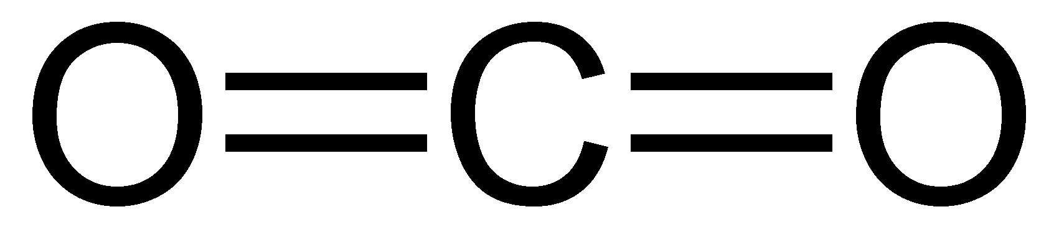
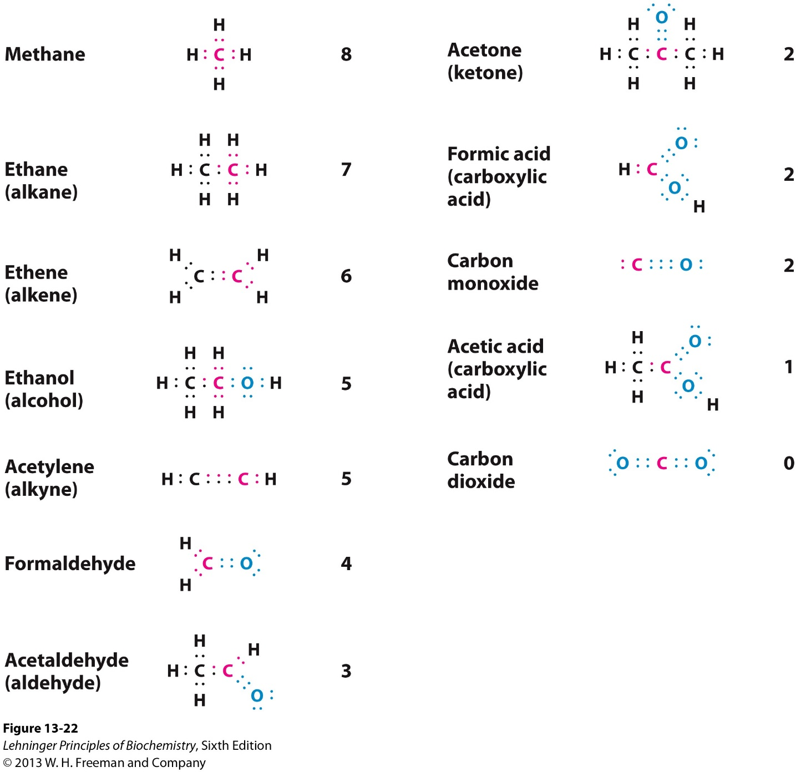
Overview of the TCA cycle
8 steps, to oxidize Acetyl-CoA into CO₂
2
8 electrons lost/transferred
4 dehydrogenation,
3 NADH, 1 FADH₂

Slide 16
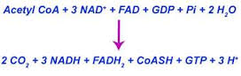
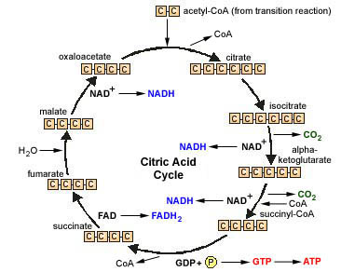
Overview of the TCA cycle by carbon numbers
Stage 1 (Step 1, 2)
2C+4C=6C
Stage 2 (Step 3, 4, 5)
6C to 5C to 4C
Stage 3 (Step 6, 7, 8)
Regenerate 4C

Slide 17
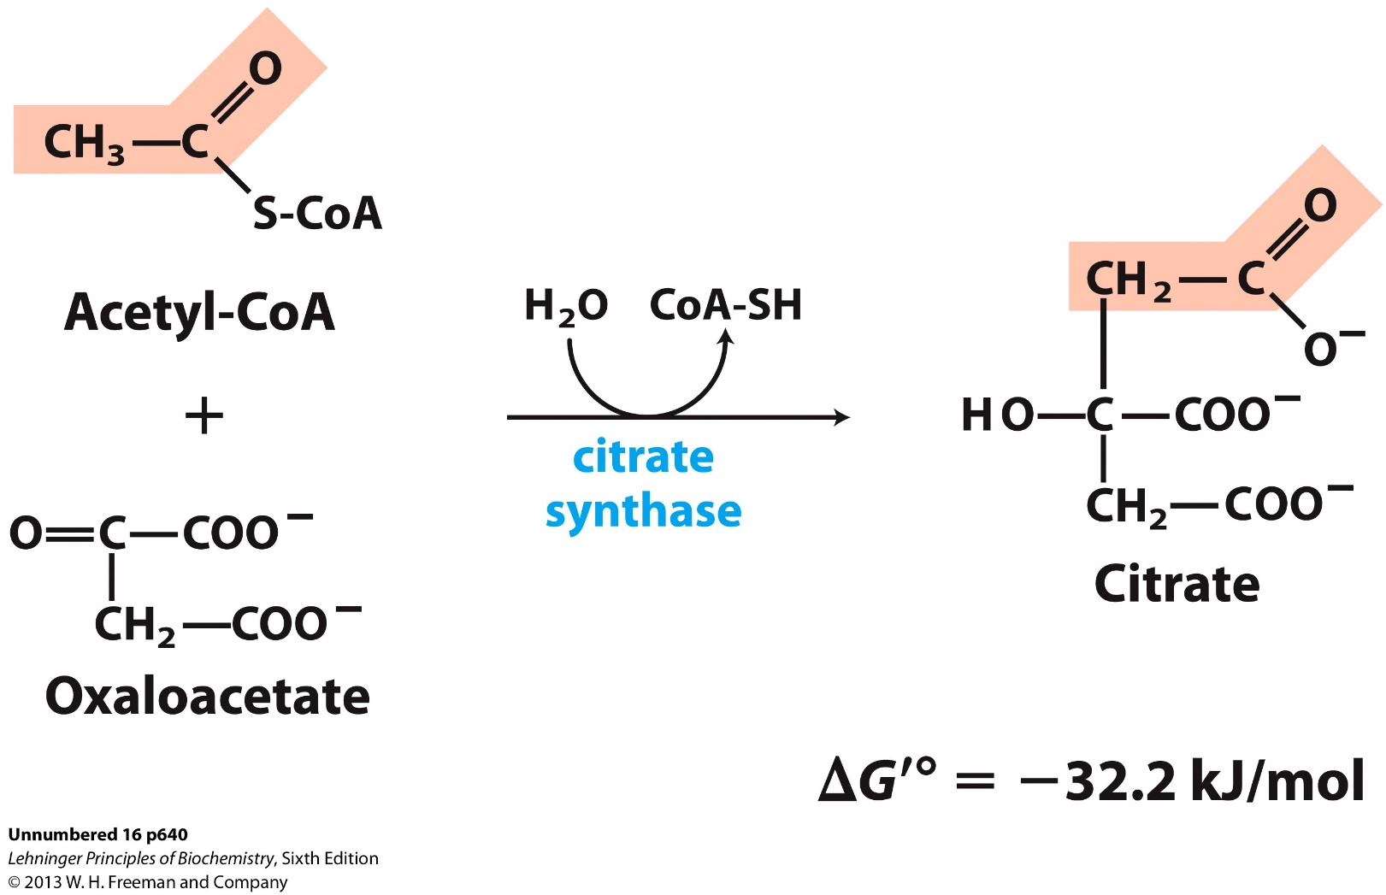
Step 1: production of Citrate from acetyl-CoA and Oxaloacetate
Irreversible, due to large negative change in Gibbs free energy.

Slide 18
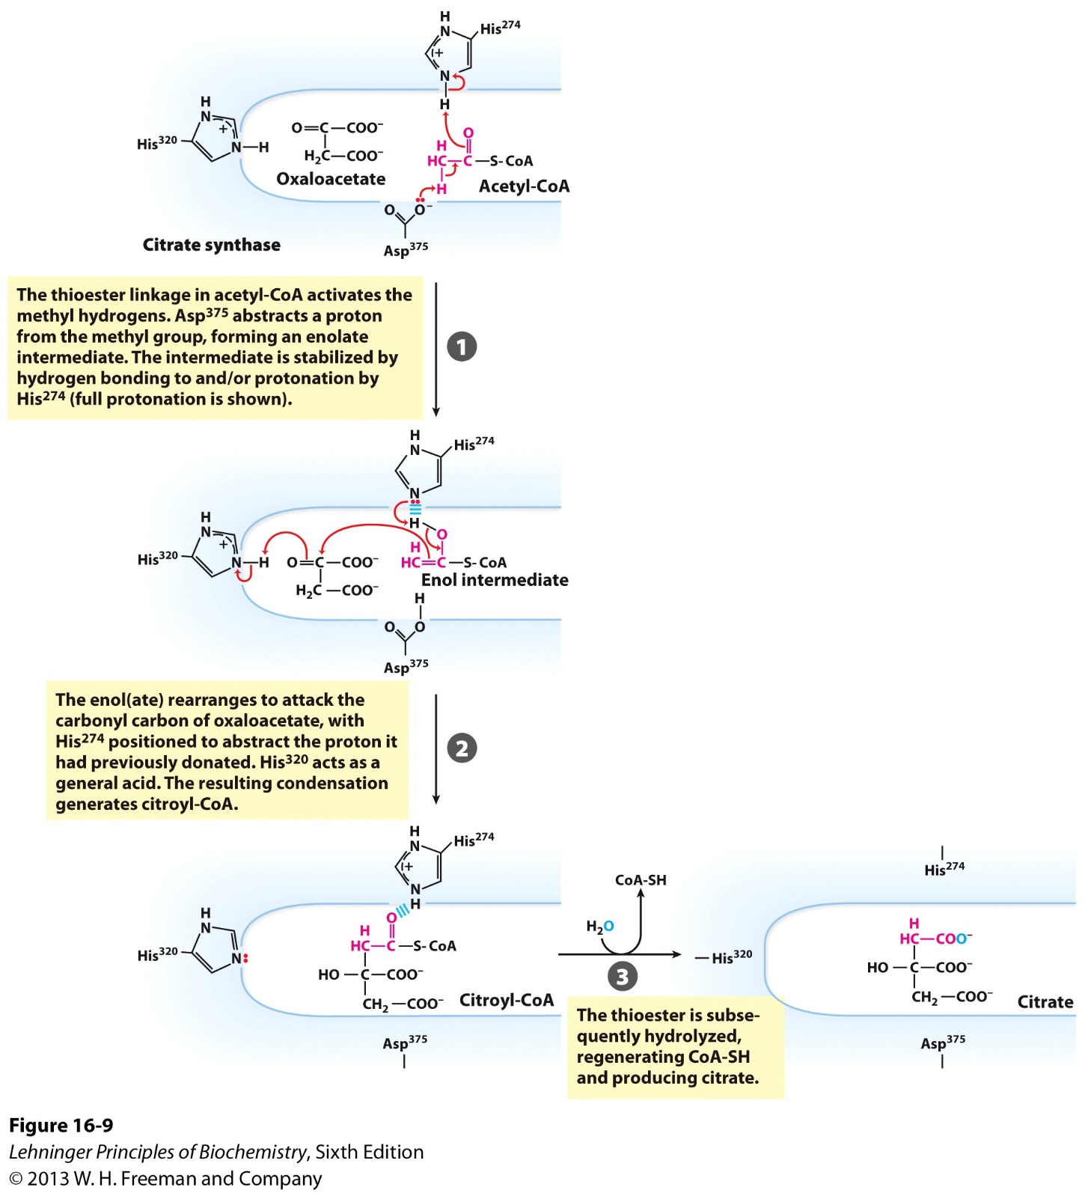
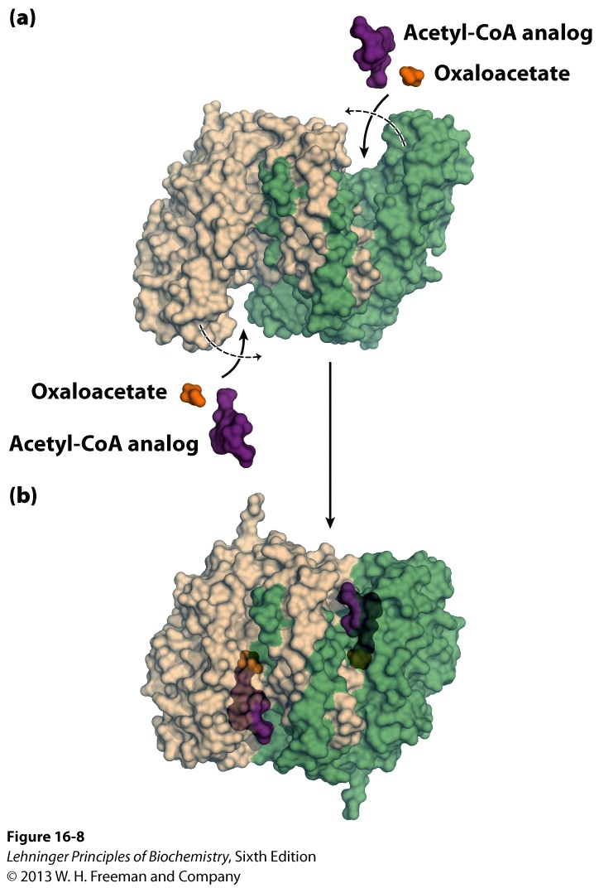
Citrate synthase acts as a general acid-base catalyst

Slide 19
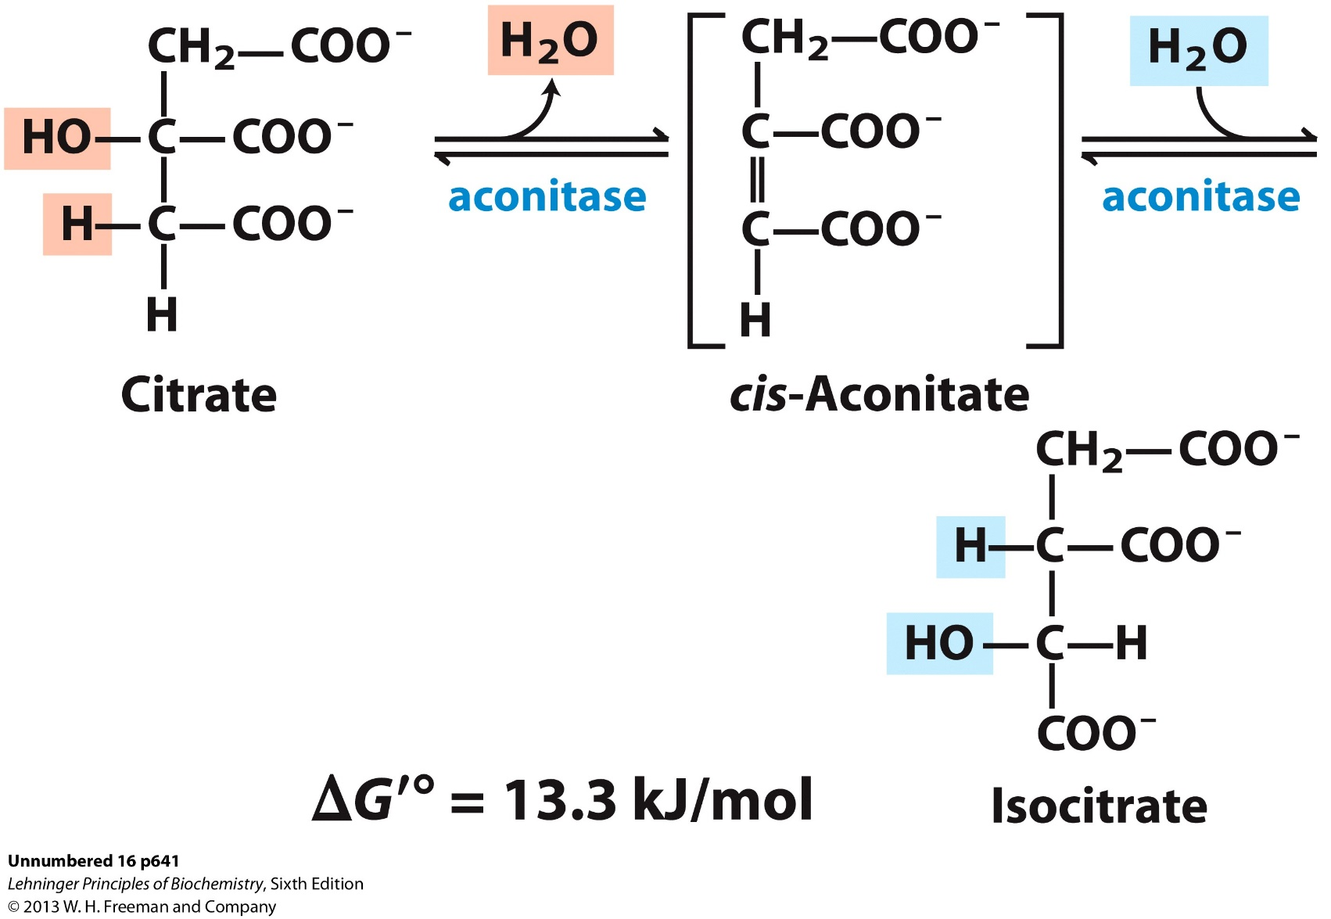
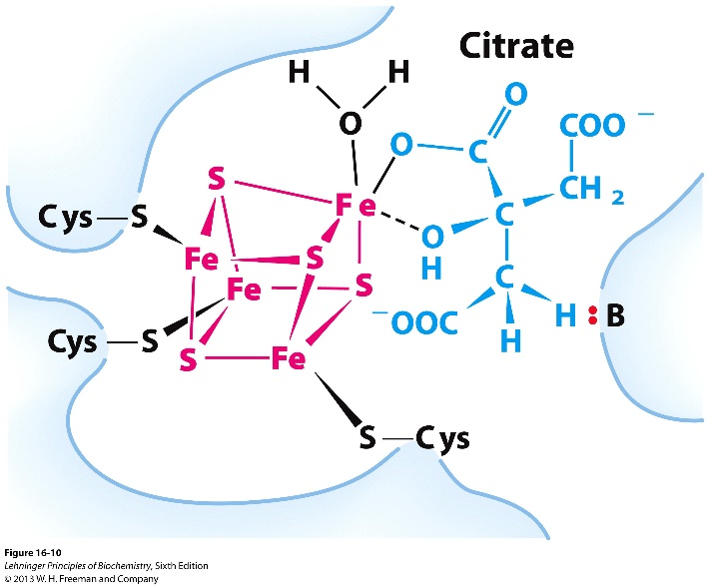
Step 2: isomerization of Citrate into Isocitrate
Trans H₂0 elimination and addition

Slide 20
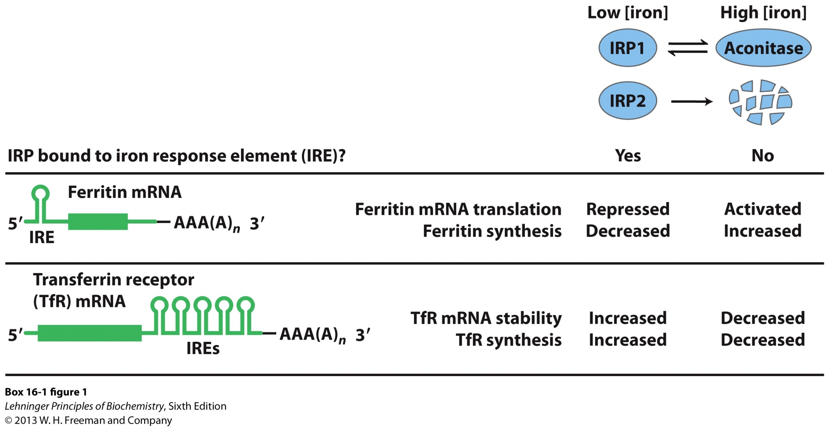
Moonlighting of Aconitase as IRP
Ferritin is an iron storage protein;
Transferrin is an iron transporting protein.

Slide 21
Overview of the TCA cycle by carbon numbers
Stage 1 (Step 1, 2)
2C+4C=6C
Stage 2 (Step 3, 4, 5)
6C to 5C to 4C
Stage 3 (Step 6, 7, 8)
Regenerate 4C

Slide 22
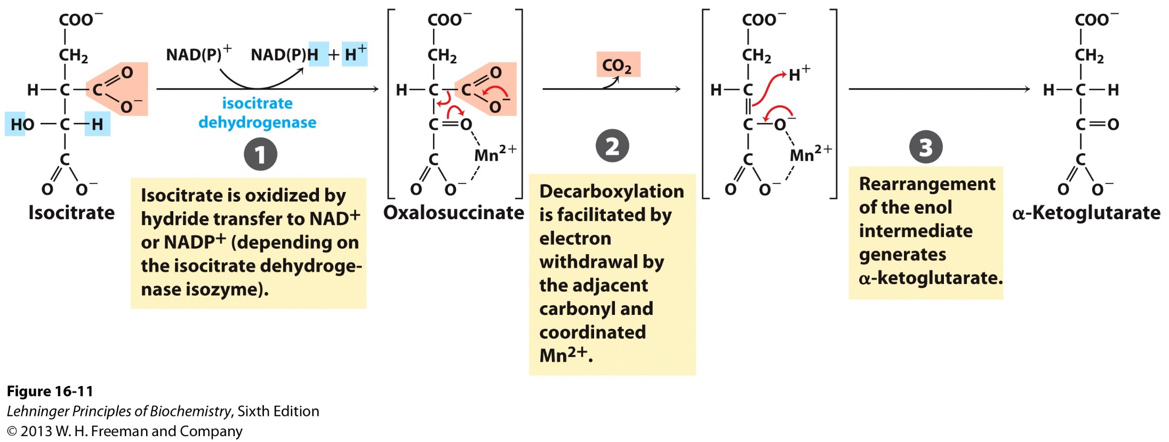
Step 3: oxidative decarboxylation of isocitrate into α-ketoglutarate
ΔG^{’o} = - 7.1 kJ/mol

Slide 23
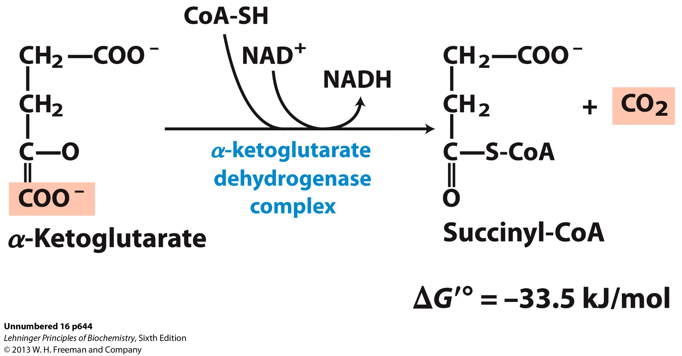
Step 4: oxidative decarboxylation of α-Ketoglutarate into Succinyl-CoA

Slide 24
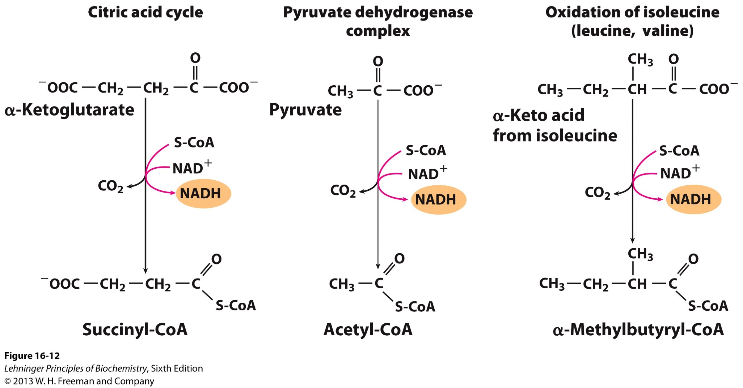
α-ketoglutarate dehydrogenase is similar to the pyruvate dehydrogenase and branched chain a-keto acid dehydrogenase complexes

Slide 25
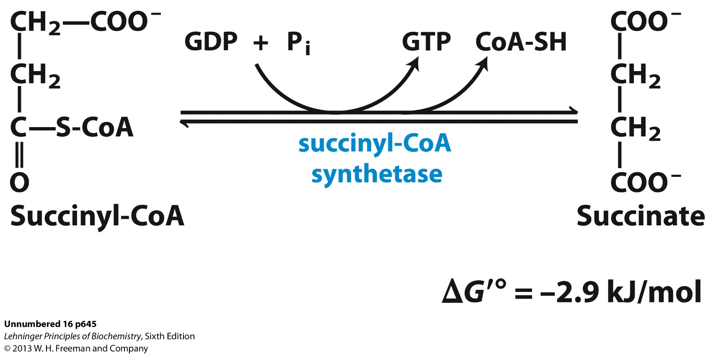
Step 5: production of GTP and Succinate from breakdown of Succinyl-CoA

Slide 26
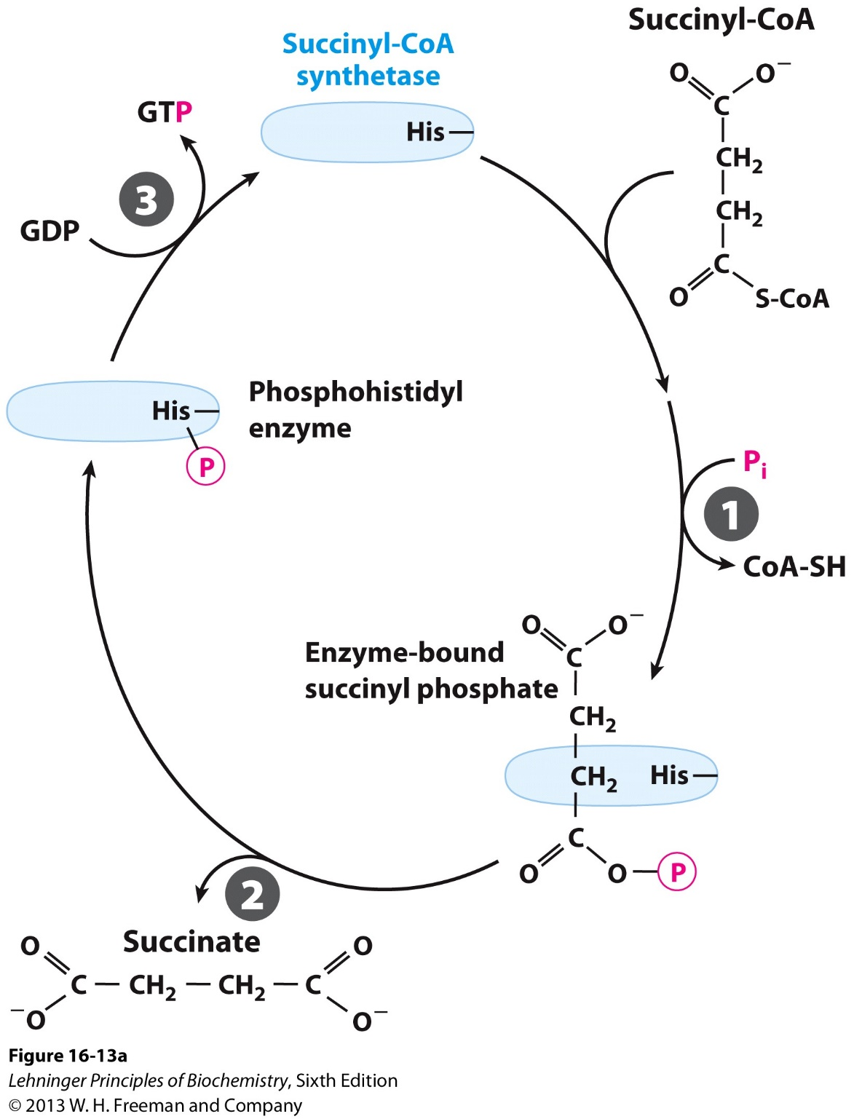
Succinyl-CoA synthetase catalyzes the substrate-level phosphorylation via a phosphorylated enzyme intermediate
GTP can be converted to ATP.
No ATP is generated in TCA cycle

Slide 27
Overview of the TCA cycle by carbon numbers
Stage 1 (Step 1, 2)
2C+4C=6C
Stage 2 (Step 3, 4, 5)
6C to 5C to 4C
Stage 3 (Step 6, 7, 8)
Regenerate 4C

Slide 28
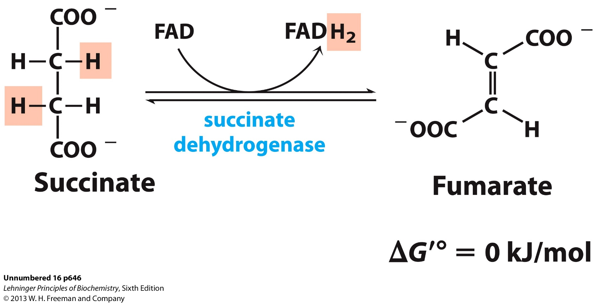
Step 6: oxidation of Succinate to Fumarate
A competitive inhibitor of the succinate dehydrogenase, blocks TCA cycle.

Slide 29
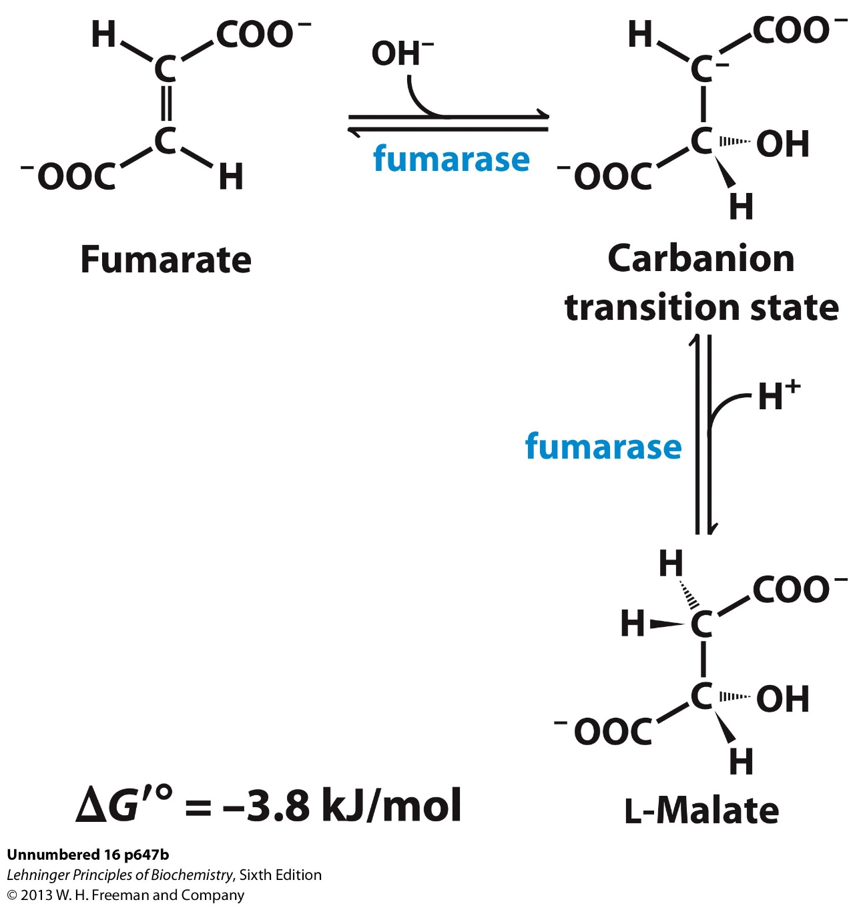
Step 7: hydration of Fumarate to L-Malate
Fumarase: strictly stereo-specific
Only L-Malate is formed

Slide 30
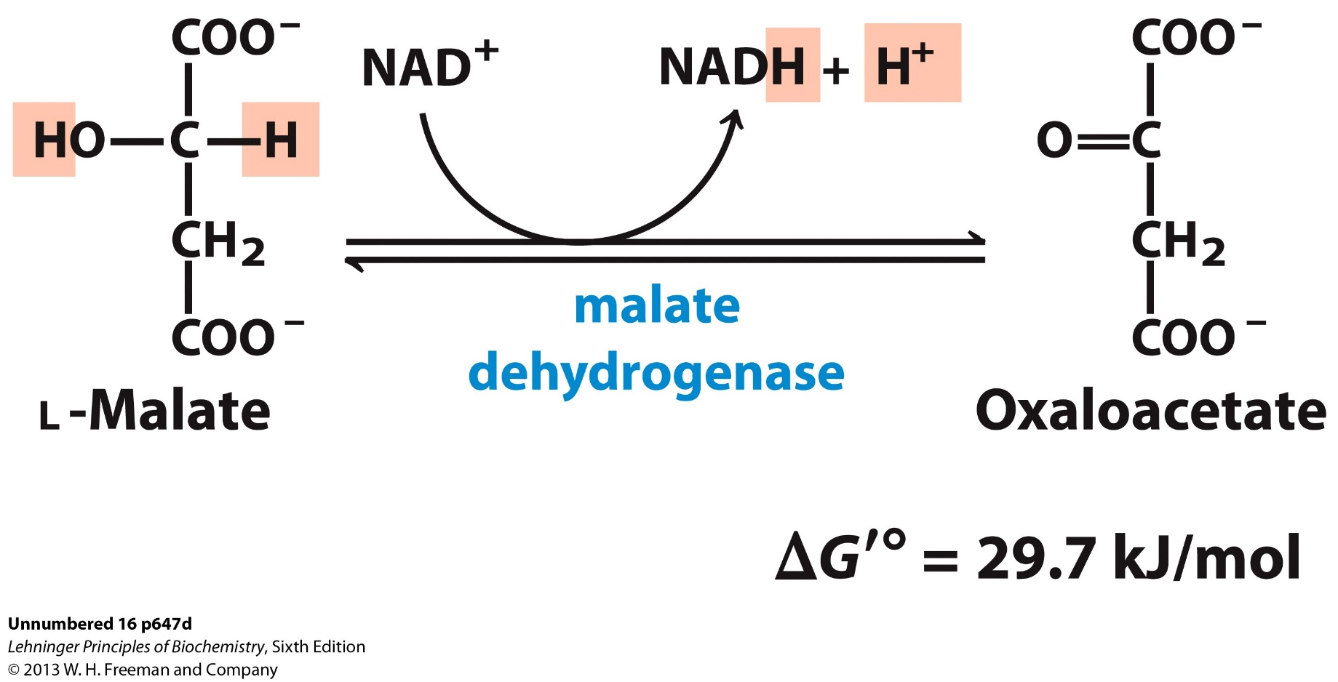
Step 8: oxidation of Malate to re-generate Oxaloacetate
The actual [Oxaloacetate] in cells is extremely low ( <10⁻⁶ M), owing to the highly exergonic next step.

Slide 31
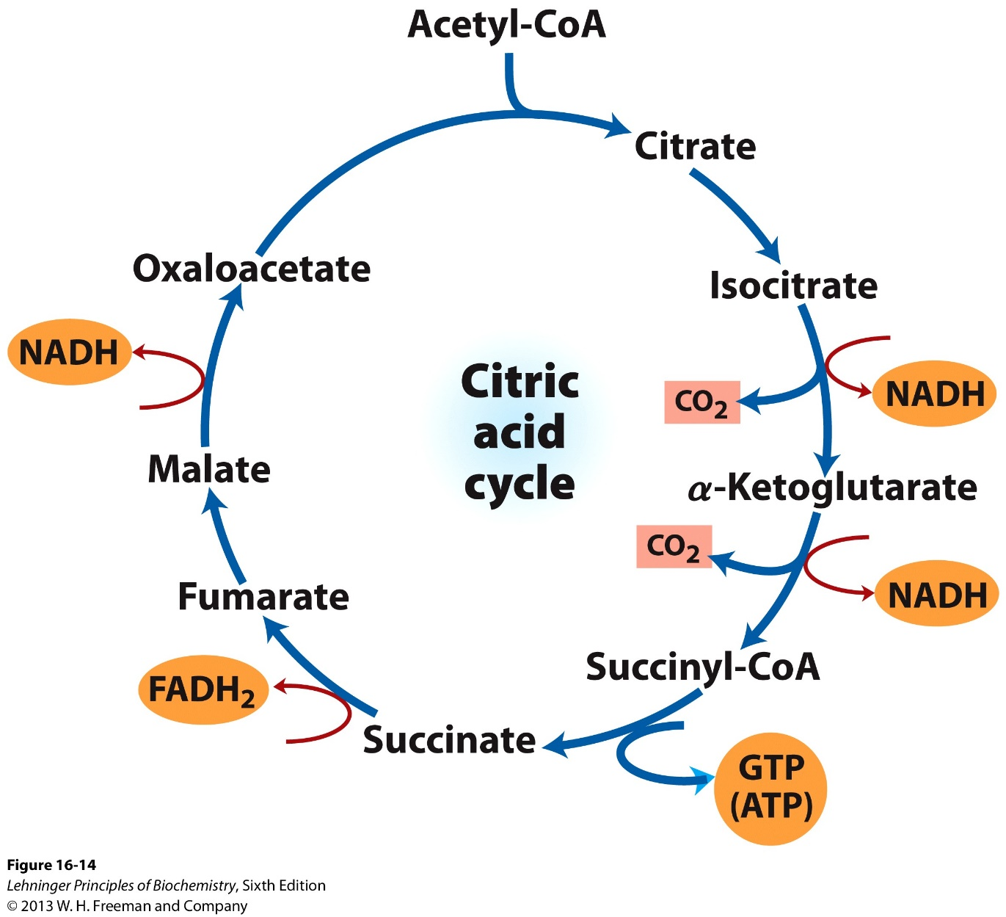
Overall reaction of the TCA cycle and yield
8 steps, to oxidize Acetyl-CoA into CO₂
8 electrons lost/transferred
3 NADH, 1 FADH₂
1 GTP

Slide 32
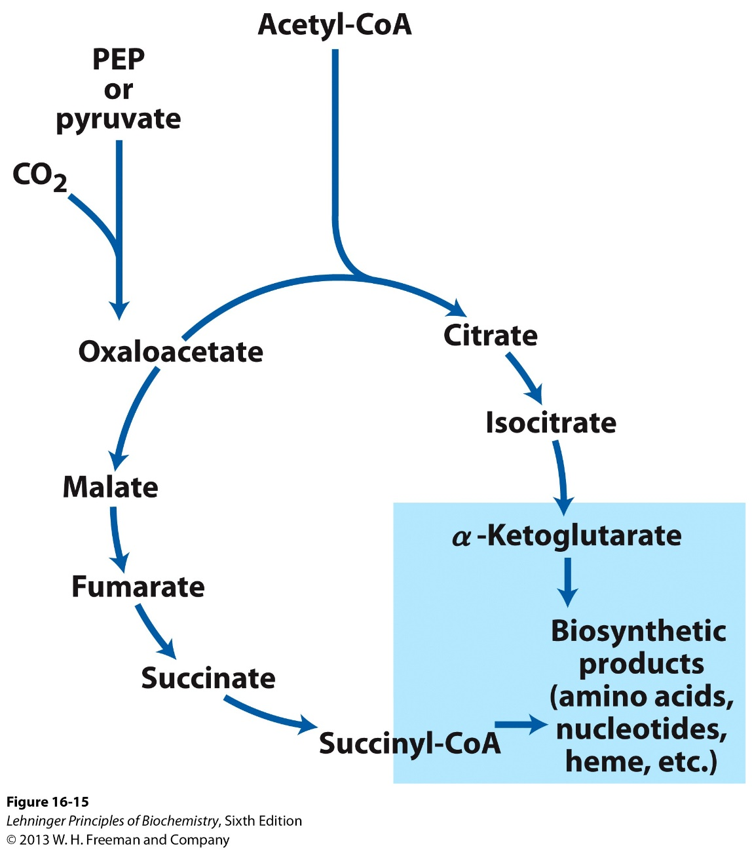
The TCA cycle provides biosynthetic precursors

Slide 33
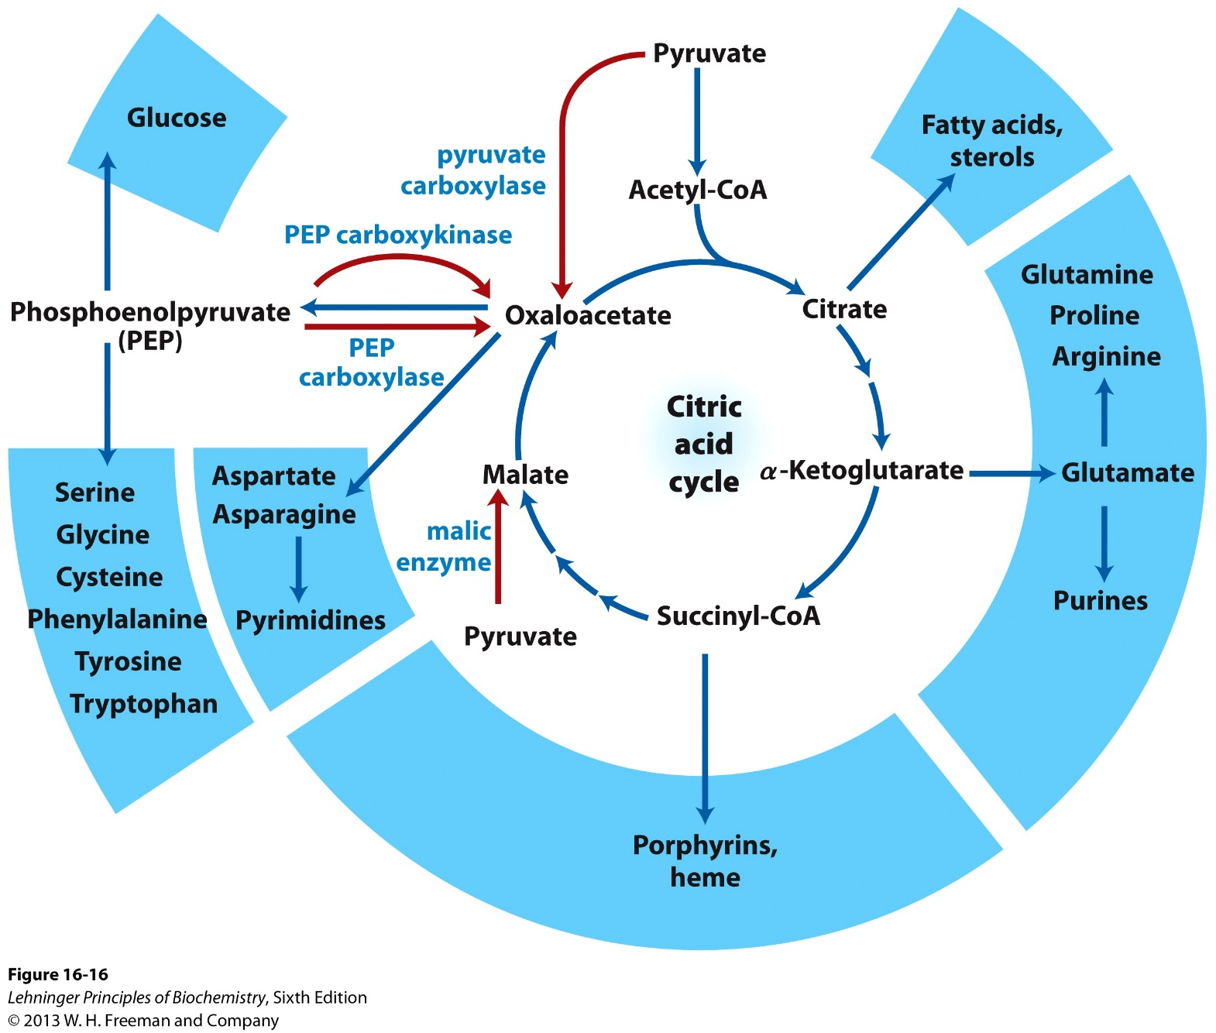
The TCA cycle connects catabolic and anabolic metabolism (amphibolic process)

Slide 34
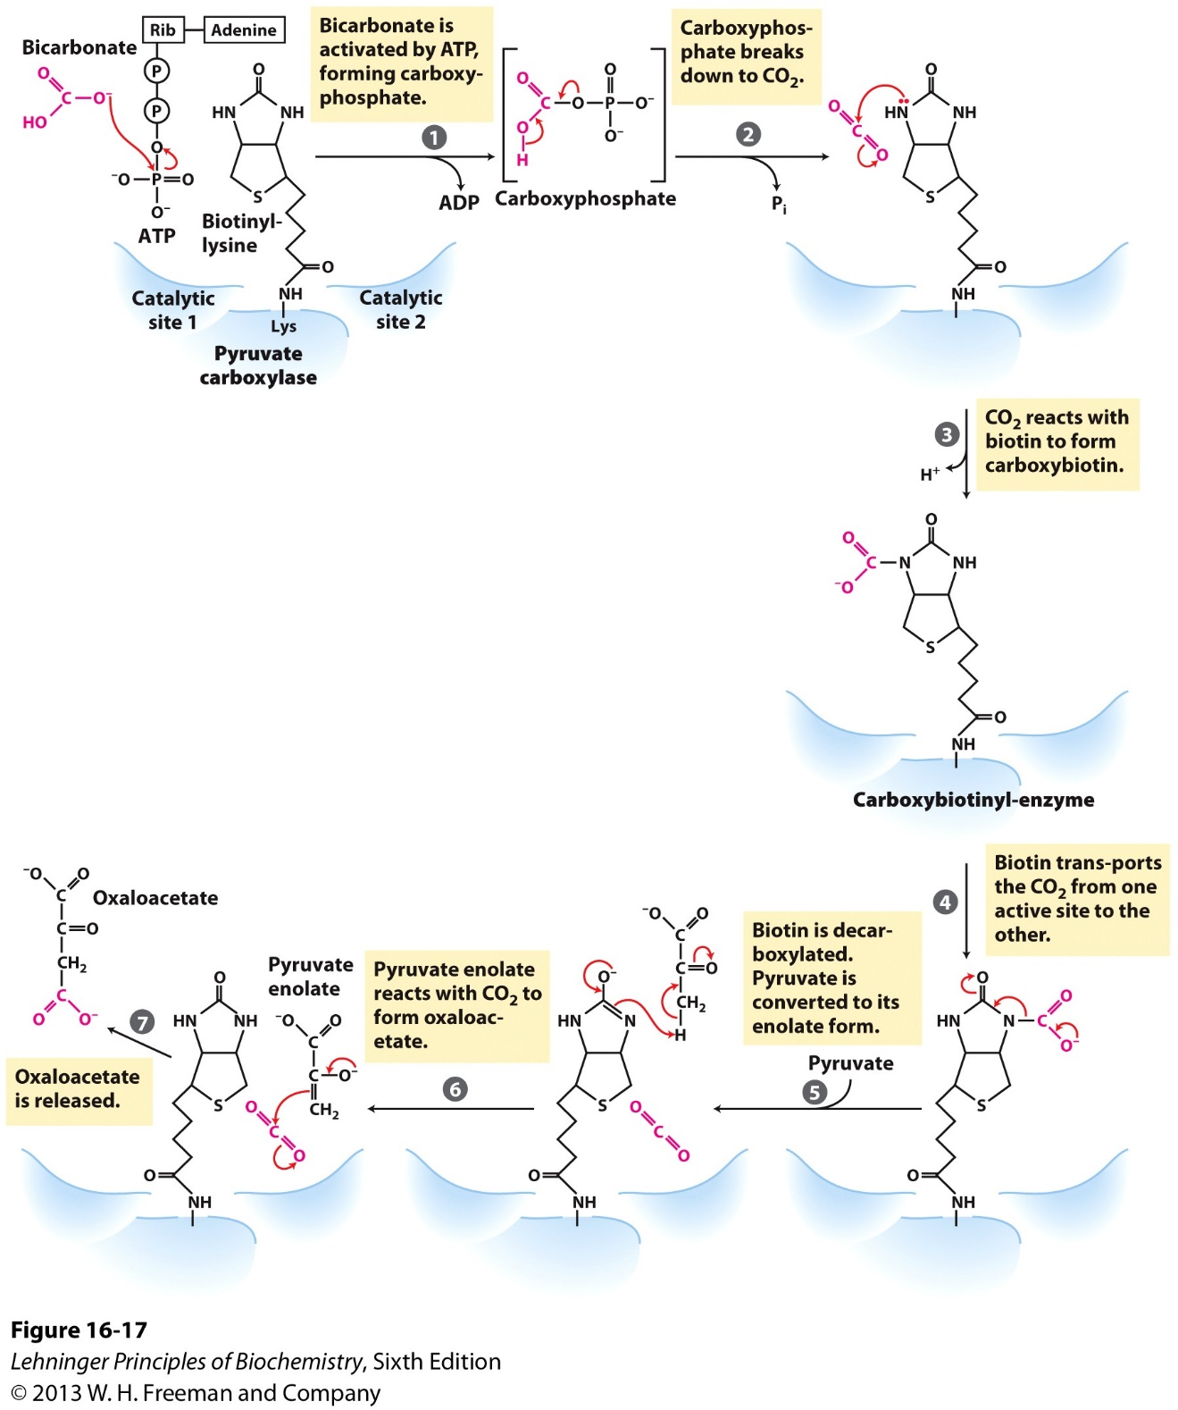
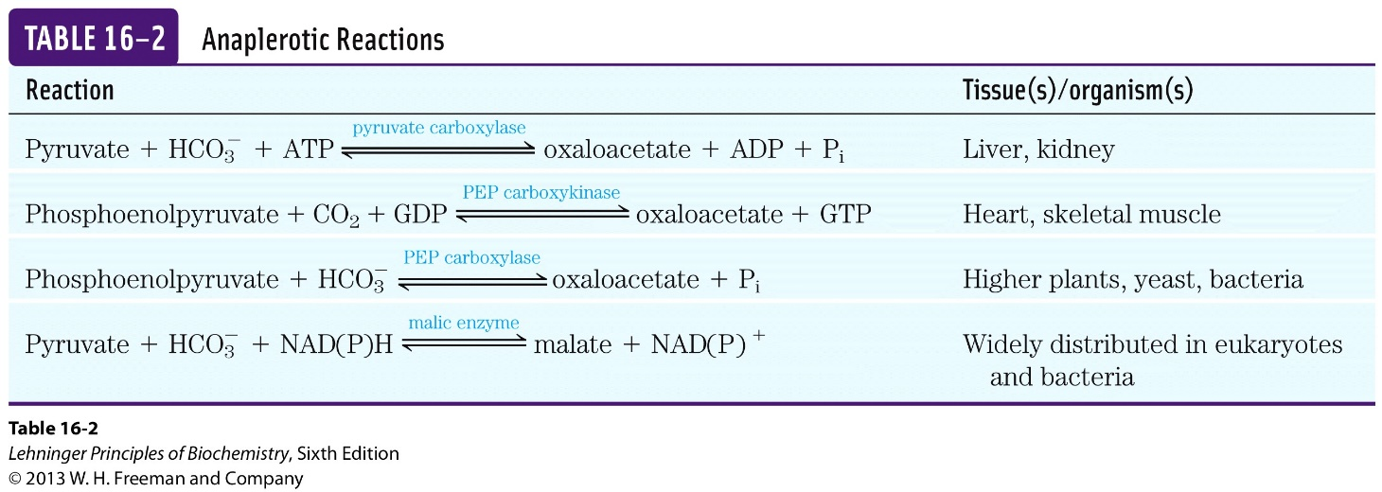
Replenishing OAA by anaplerotic reactions
The co-enzyme Biotin enable “substrate channeling” by pyruvate carboxylase

Slide 35
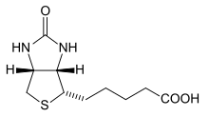
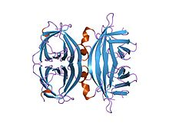
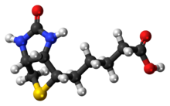
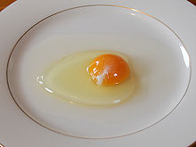
Biotin and Avidin forms one of the strongest non-covalent interactions
Avidin
Vitamin B7, Coenzyme R
Biotin-Avidin interaction:
K_{d} = ~10⁻¹⁵

Slide 36
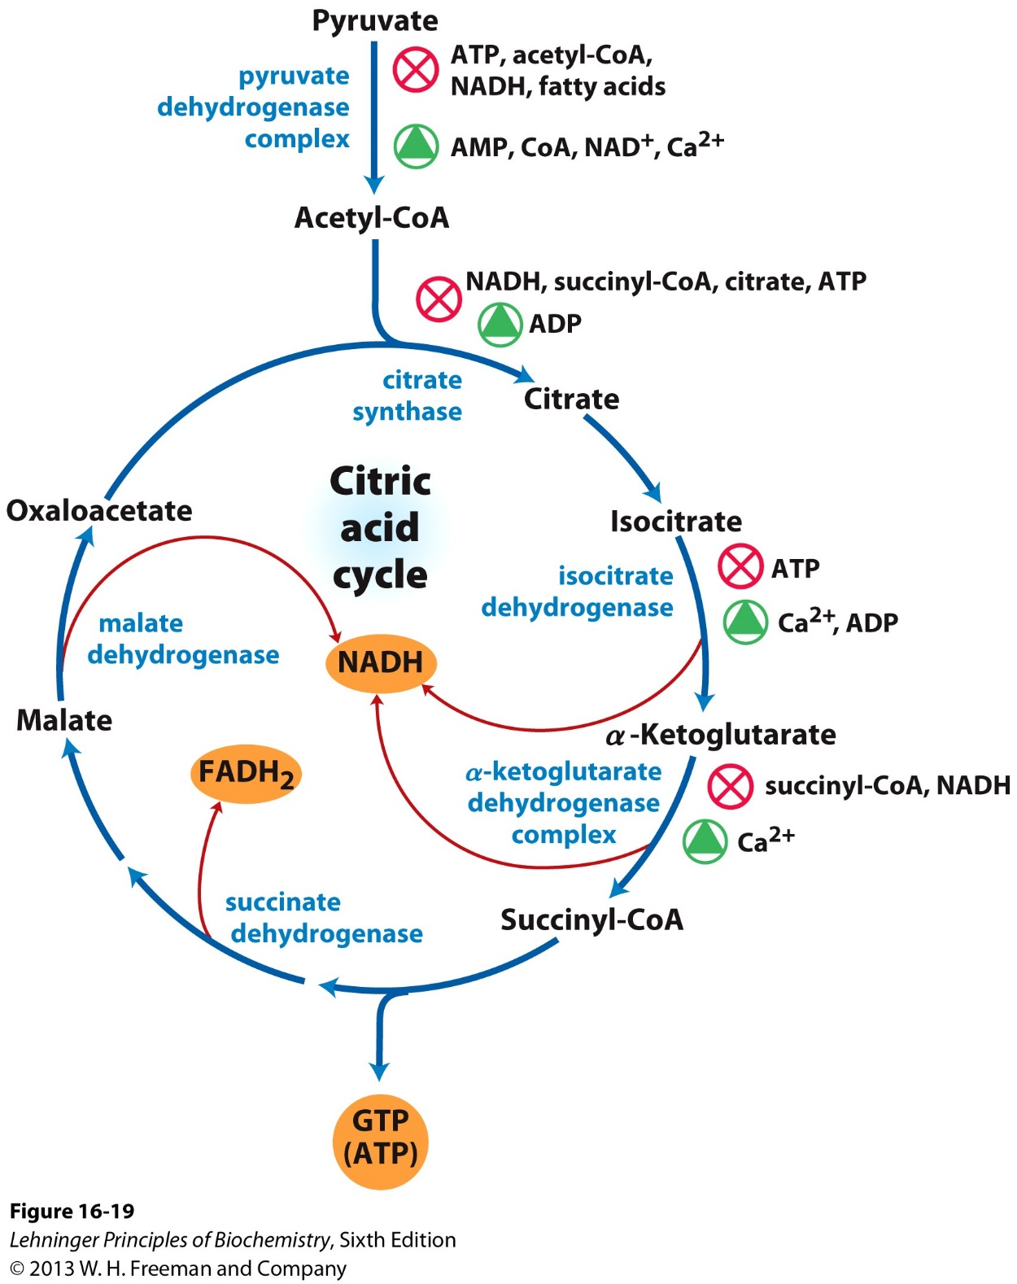
Regulation of TCA cycle
Three exergonic steps catalyzed by:
Citrate synthase
IDH
α-KG dehydrogenase complex
Allosteric regulation: Molecules indicating a low energy level or requirement of energy for the cells will activate the regulatory enzymes and vice versa

Slide 37
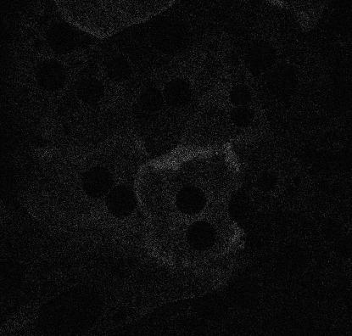
Calcium oscillations: digitized signal regulating cellular metabolism

Slide 39
Calcium signal in oxidative metabolism: amplitude vs frequency
Calcium
FAD

Slide 40
Deficiencies in TCA cycle enzymes
Rare case of inborn metabolic disorders have been identified with mutations in:
Fumarase
Succinate dehydrogenase
α-ketoglutarate dehydrogenase complex
How could patients/cells survive with these deficiencies?

